Slide 1









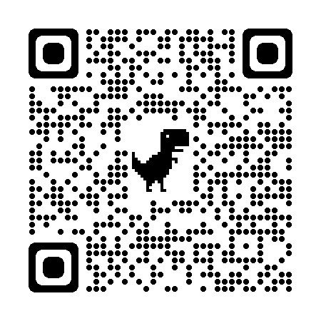
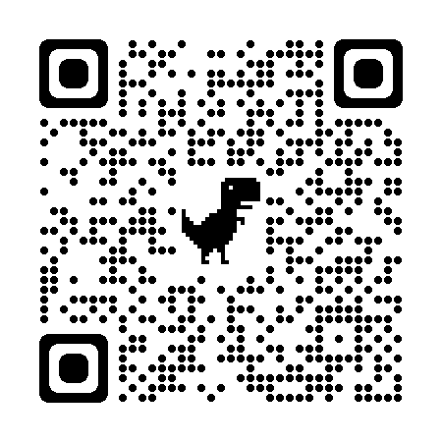



Coaching Classes
9073 700094
N-1/25 Patuli, Kol 94, Near Fire Brigade & Krisi Vikas
Upto 50% Off
T&C Applies
Artificial Intelligence, Robotics – Class III - XII
Professional AI & IT Training & Projects
VIII-XII - All Subjects & Boards
NEET, IIT-JEE (Mains & Advanced)
BCom, BBA, CA, CMA, CS, CFA, CLAT, LLB, LLM
Grooming, Ielts, Toefl, Foreign Languages
Finest Teachers, Study Materials
Mock Tests, Doubt Clearing, PTM
Counselling, 400+ Courses
20 Smart Classrooms, AC, CCTV
Professional Courses are
Proj-Based, Certification
Oriented, Career Focused
www.anodiam.com
anirban@anodiam.com
Follow
for Discounts
App Download

Slide 2

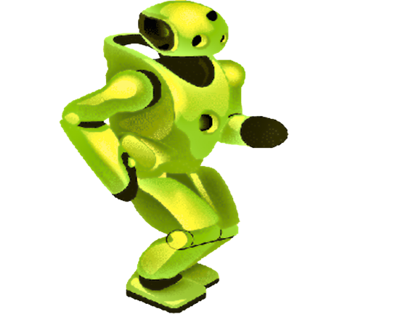
Upto 50% Off
T&C Applies
Artificial Intelligence
N-1/25 Patuli, Kol 94, Near Fire Brigade & Krisi Vikas
9073 700094
www.anodiam.com
anirban@anodiam.com
Follow
for Discounts
App Download

Slide 3

Artificial Intelligence
N-1/25 Patuli, Kol 94
Near Fire Brigade & Krisi Vikas
9073 700094
Upto 50% Off
T&C Applies
Follow
for Discounts
App Download
Artificial Intelligence, Robotics - Class III-XII
Professional AI & IT Training & Projects Data Science, Computer Vision, NLP, DSP
Python, Data Analytics, C, C++, IoT, Robotics
Java, .NET, JavaScript, ReactJS, Native, PHP
DevOps, Docker, Kubernetes, Cloud
Database, Firebase, Cyber Sec, Automation Test
Pmp, Agile, Office, Adv Excel, Tally, Html, Css
Globally experienced faculty from prestigious organizations, fun & easy learning
Project based, Career Focused, Certification Help, Smart Classrooms, AC, CCTV
www.anodiam.com || anirban@anodiam.com

